Slide 1

Unlocking web archives through metadata, seed lists and derived data
Frédéric Clavert and Valérie Schafer
C²DH, University of Luxembourg
DH Benelux 2022, Luxembourg

Slide 2

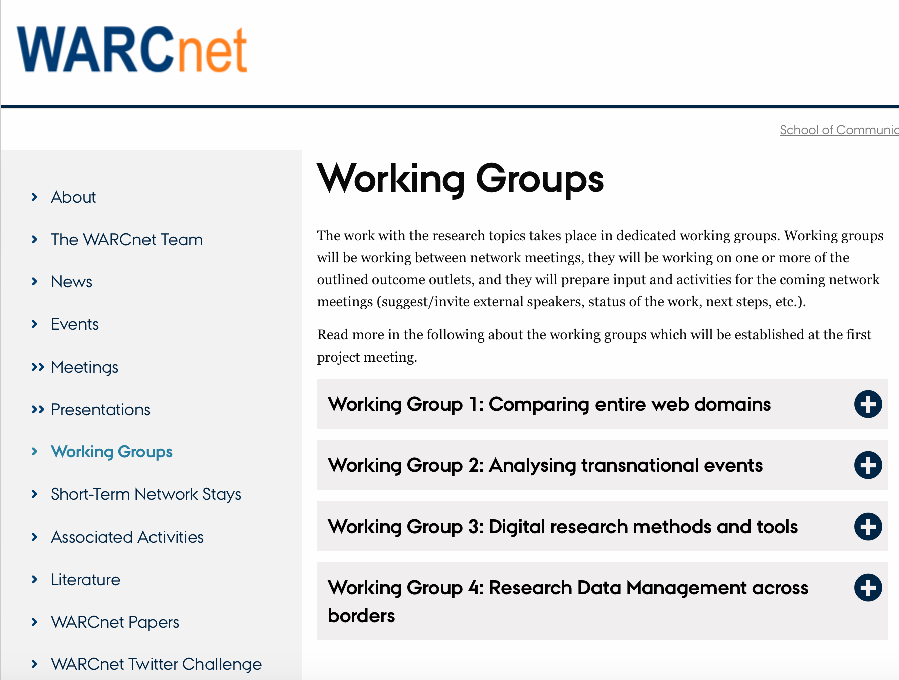
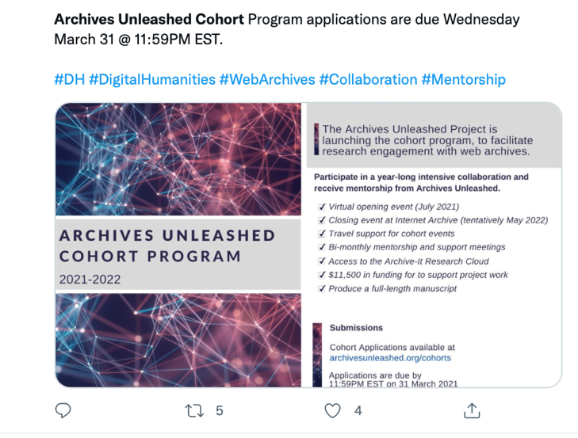
Two research projects : WARCnet and AWAC2

Slide 3
Exploration of seed lists, assets and limits
Table created by Karin De Wild

Slide 4
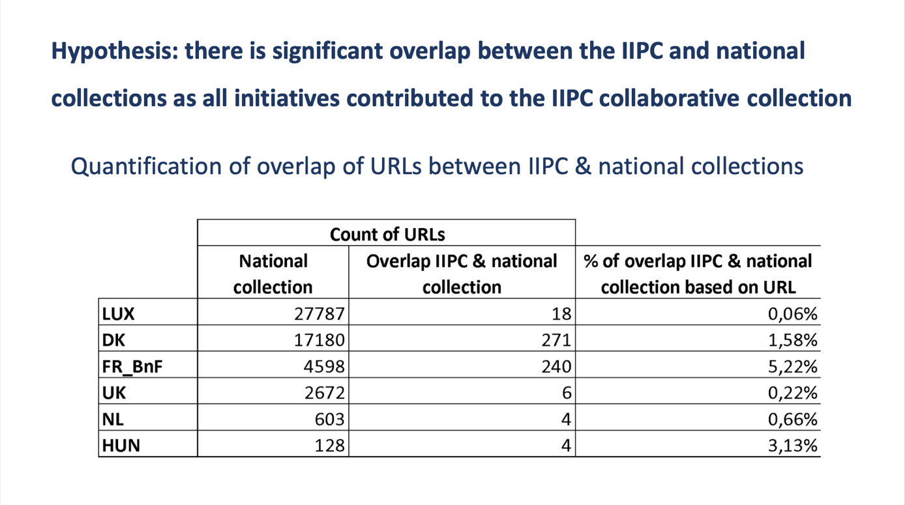
Presentation by Friedel Geeraert of her hypothesis related to overlaps between national collections and IIPC collection
and results (final meeting of our datathon)

Slide 5
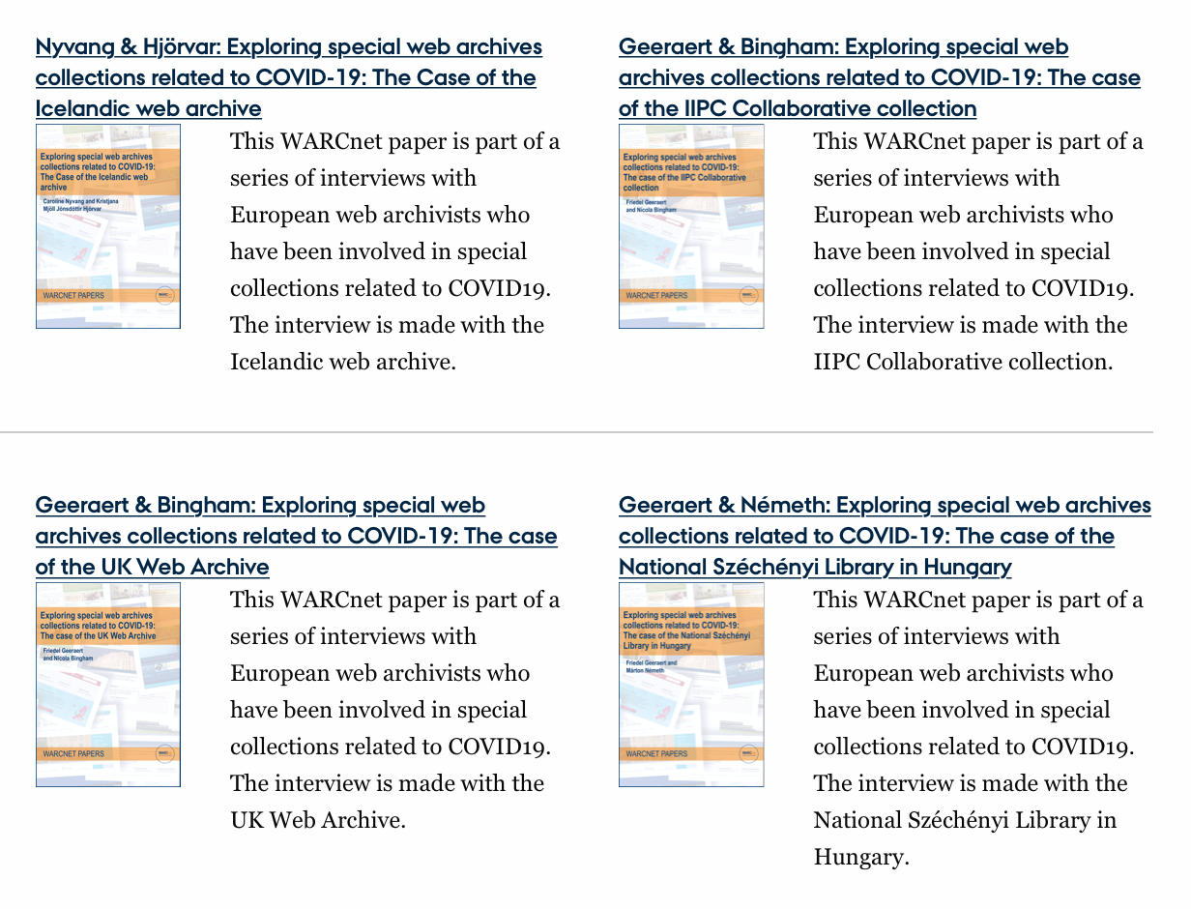
https://cc.au.dk/en/warcnet/warcnet-papers/

Slide 6
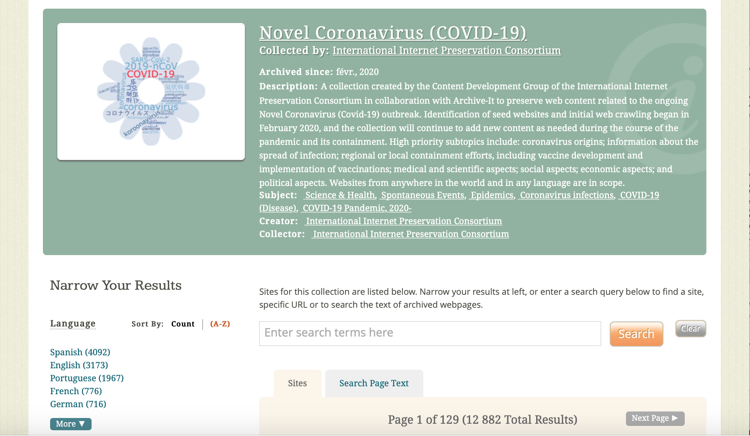
The AWAC2 project: exploring a big dataset through ARCH
On Archive-It

Slide 7
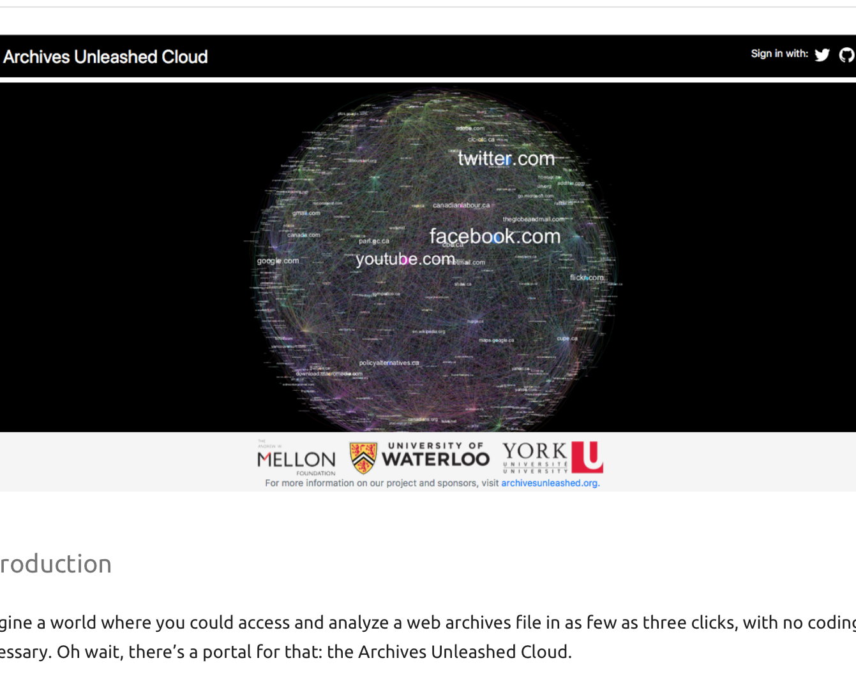
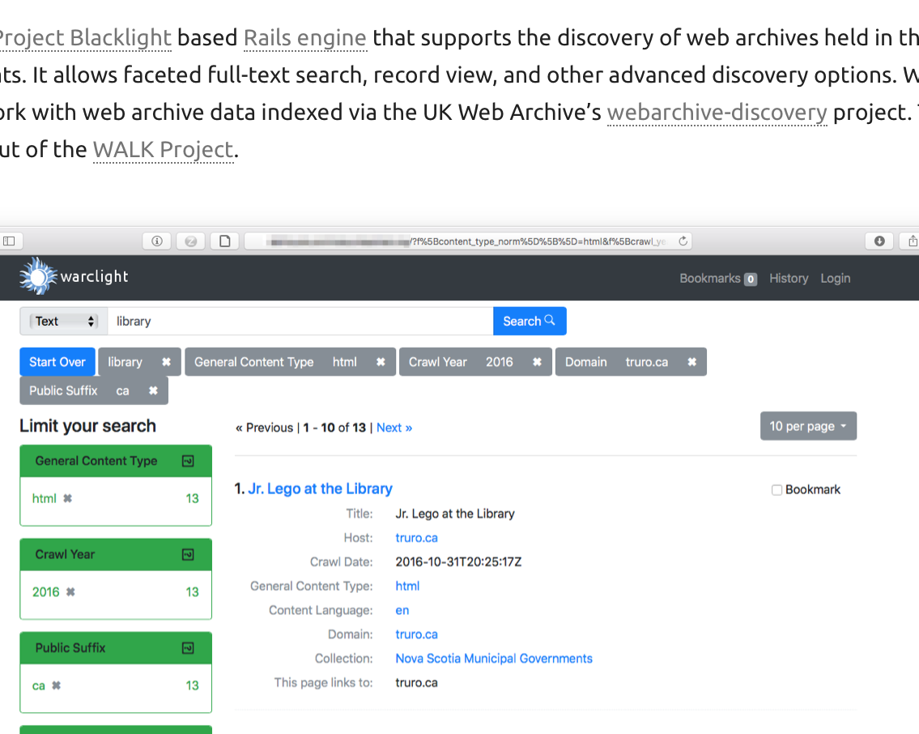
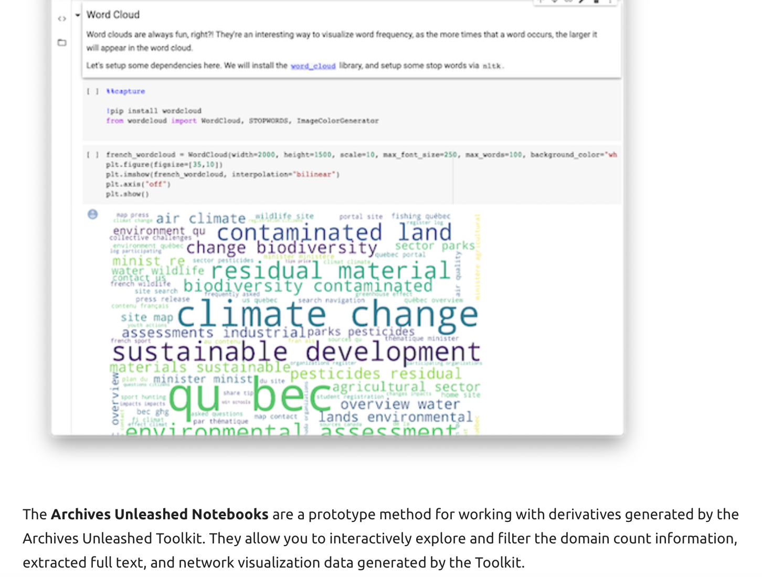
A full set of tools and discovery options in the Archives Unleashed Toolkit https://archivesunleashed.org/aut/
Notes:
VS

Slide 8
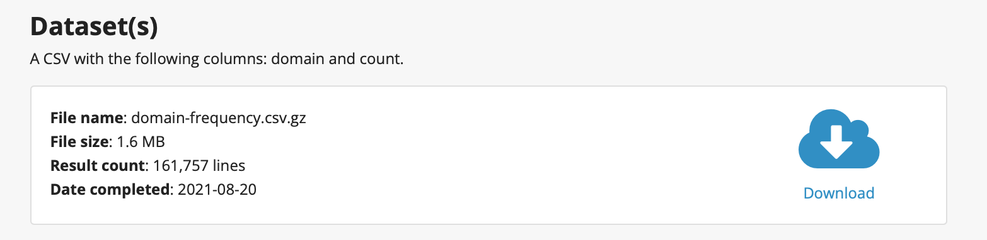
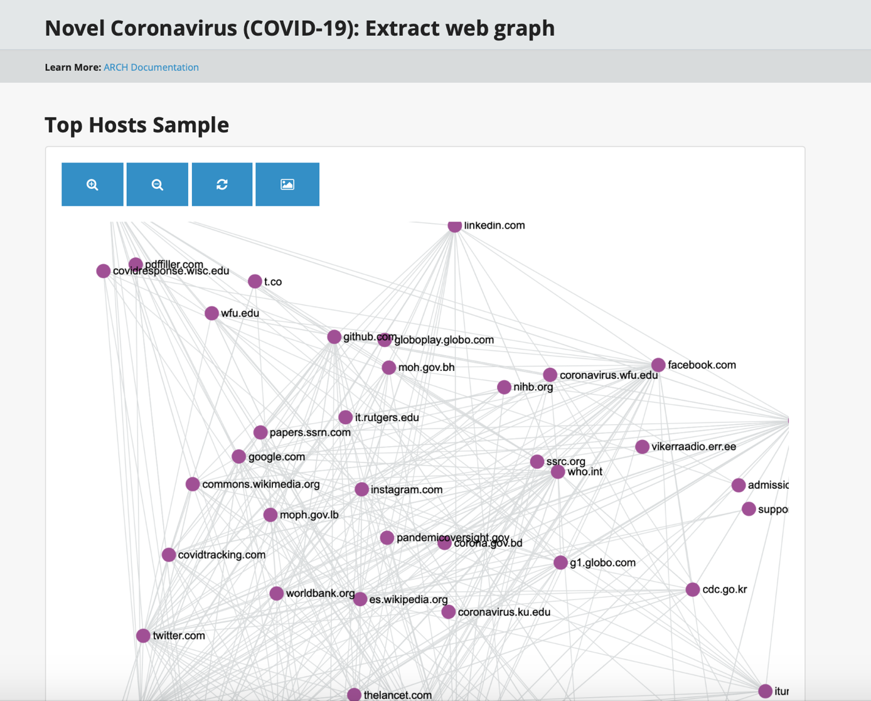

Slide 9
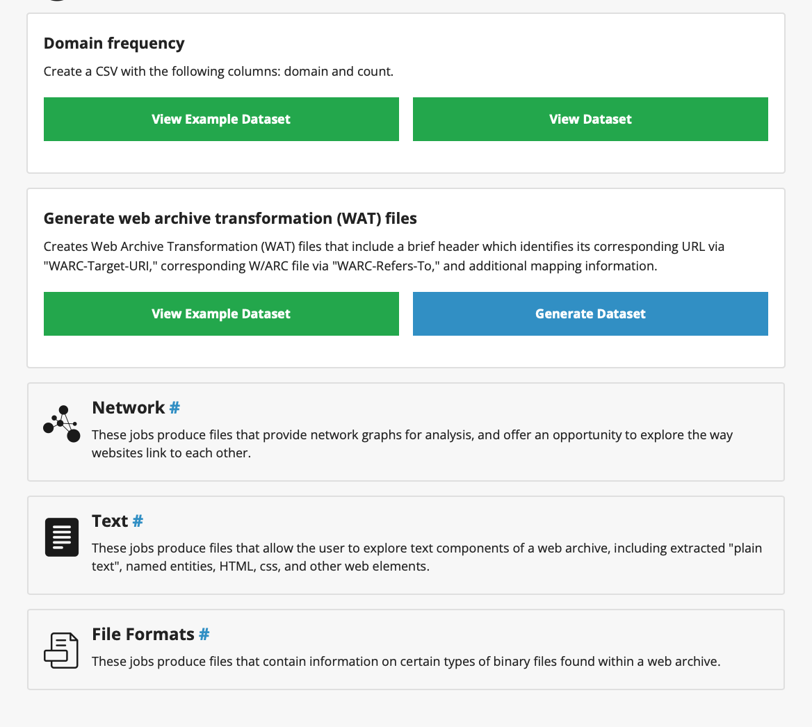
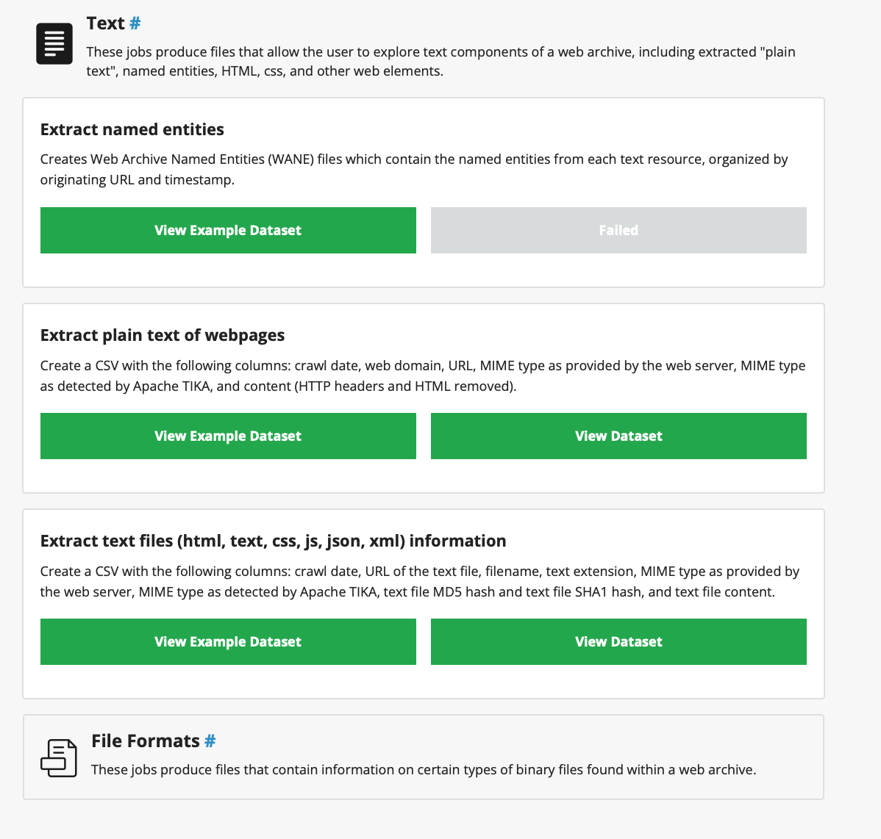

Slide 10
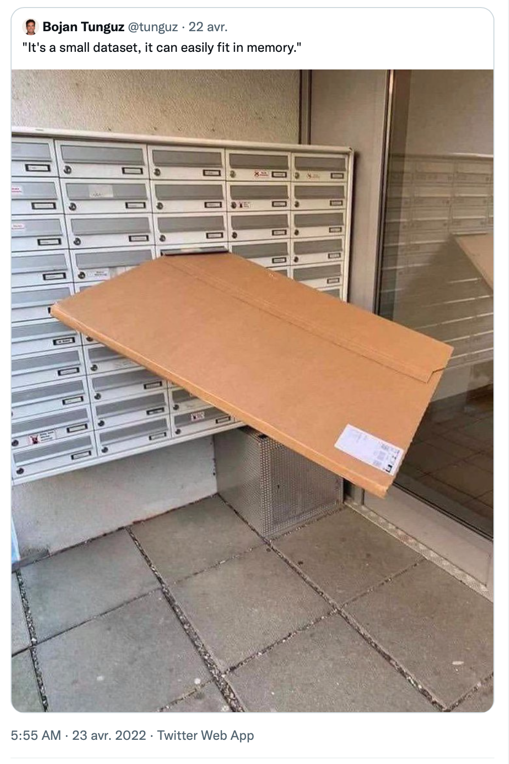
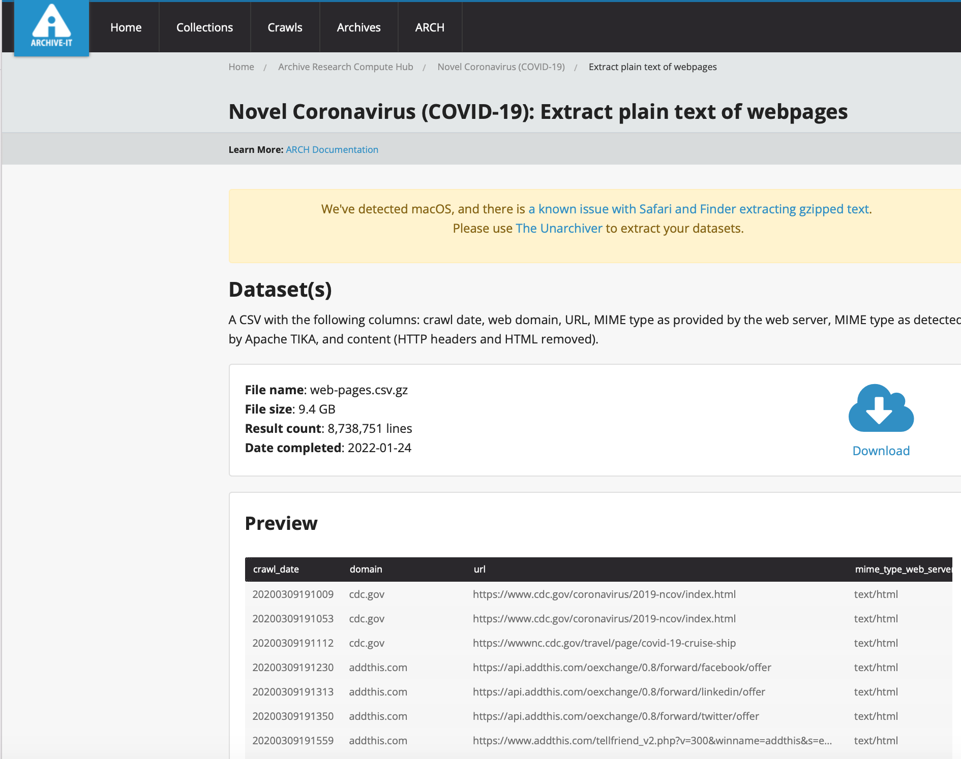

Slide 11
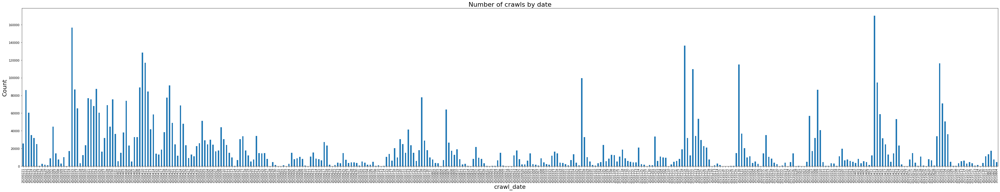
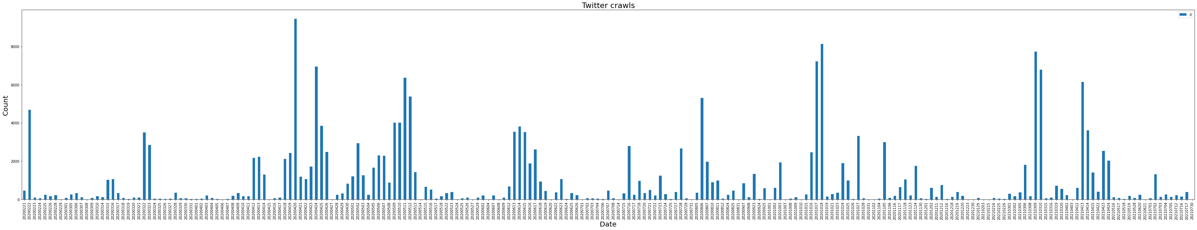
By Frédéric Clavert

Slide 12
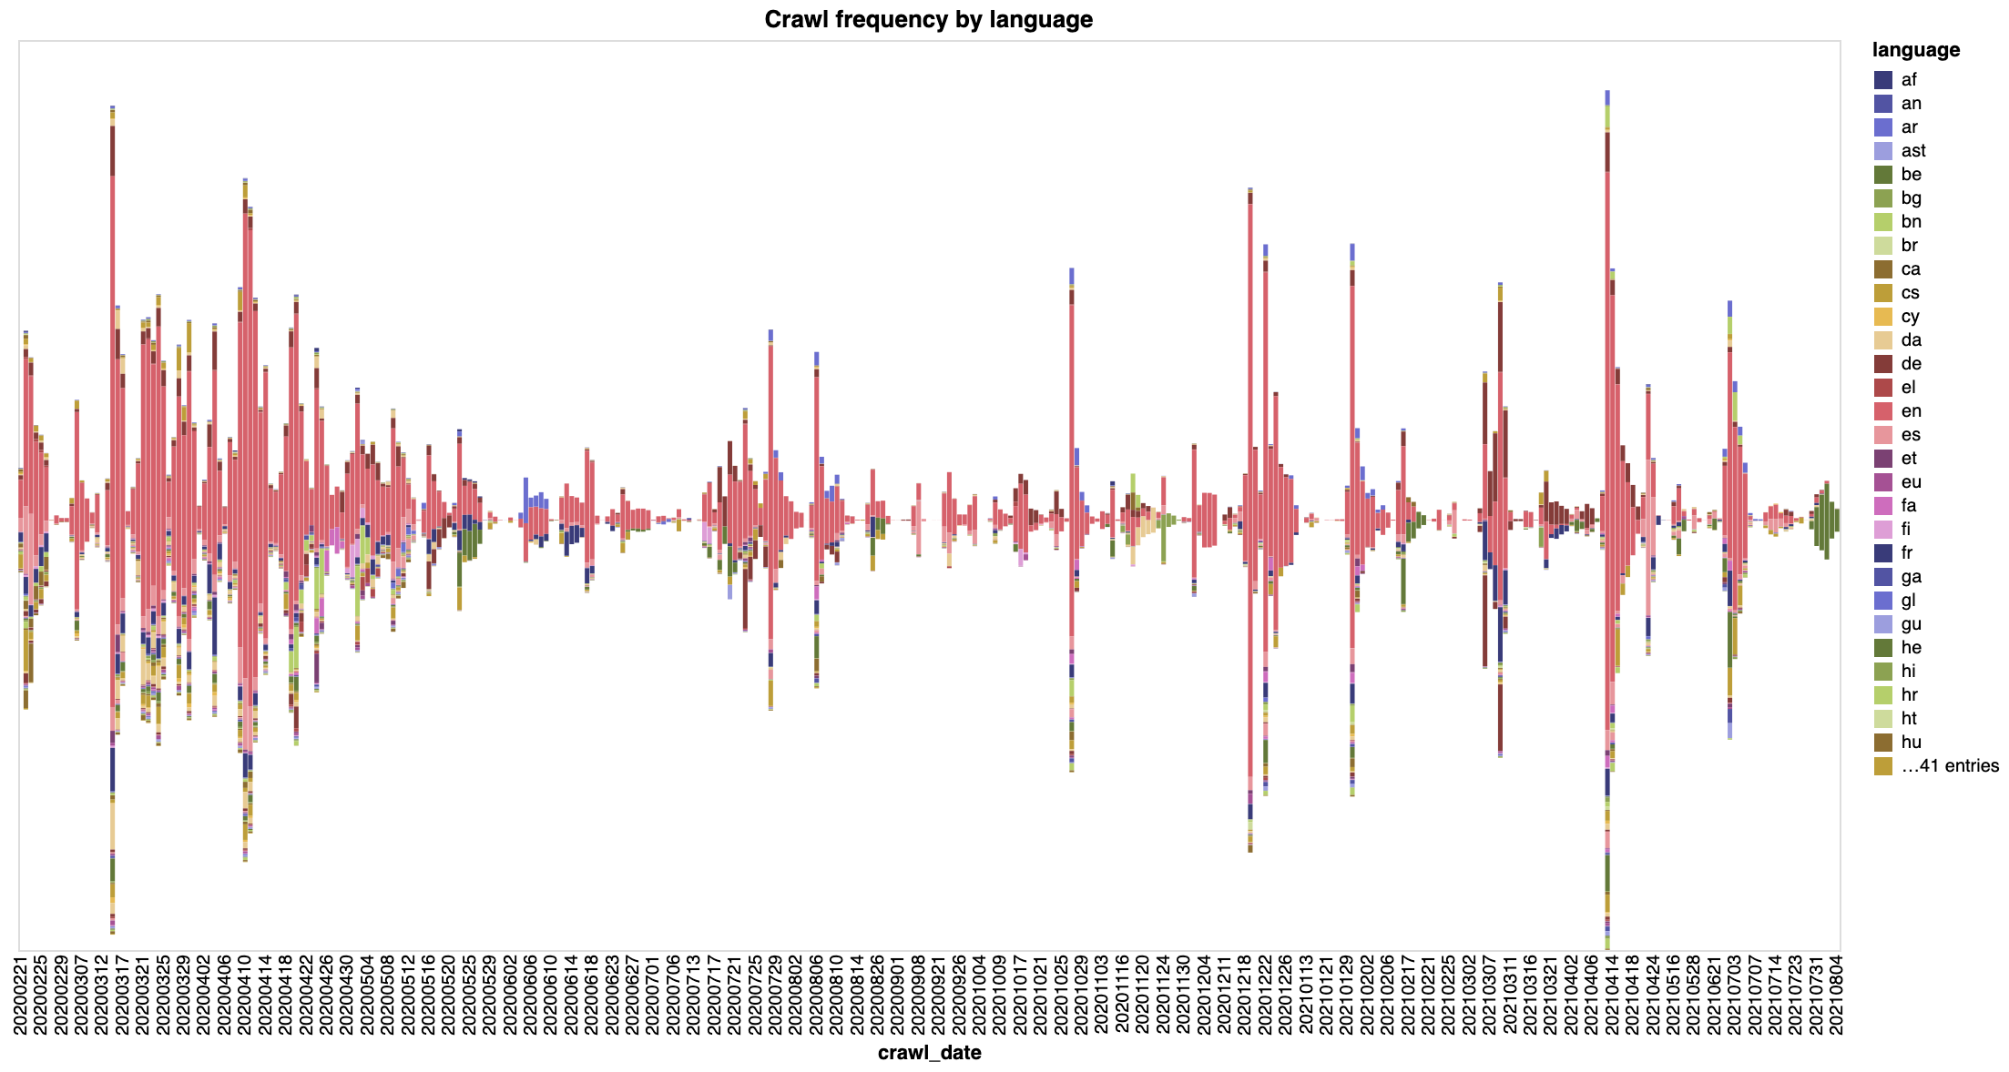
By Frédéric Clavert

Slide 13
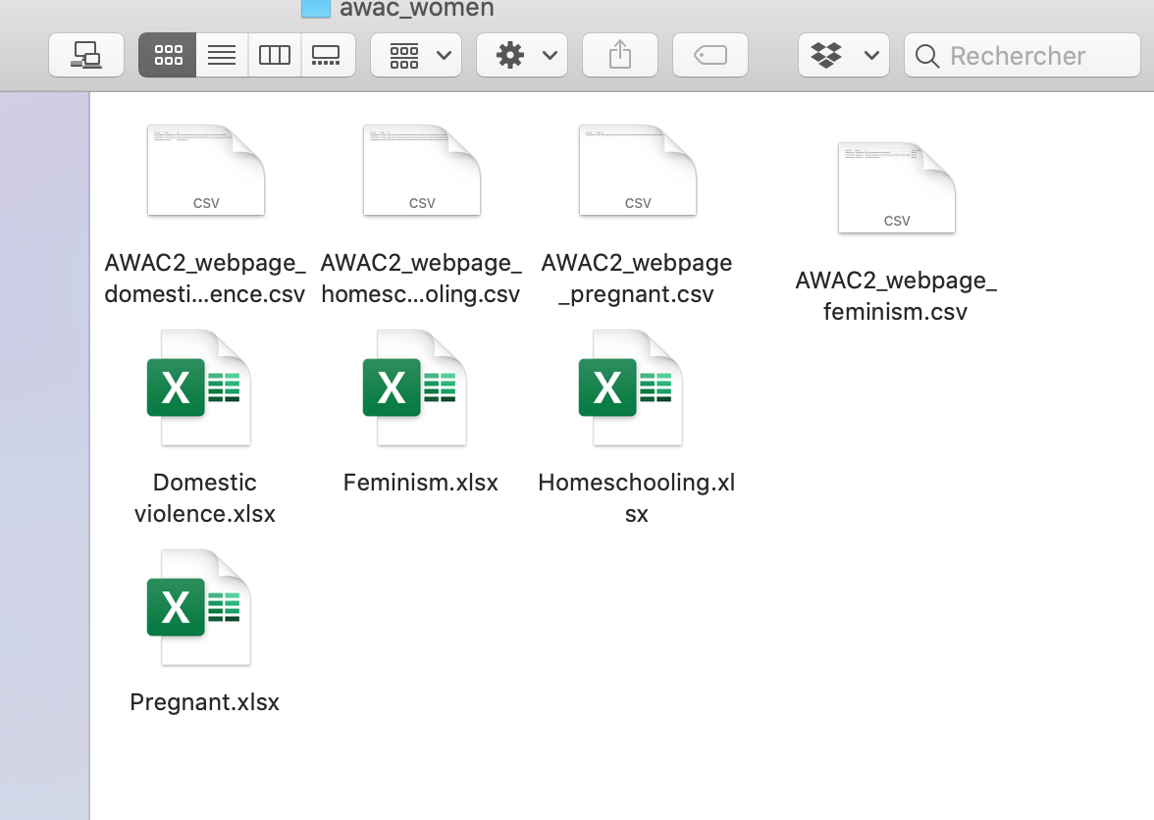
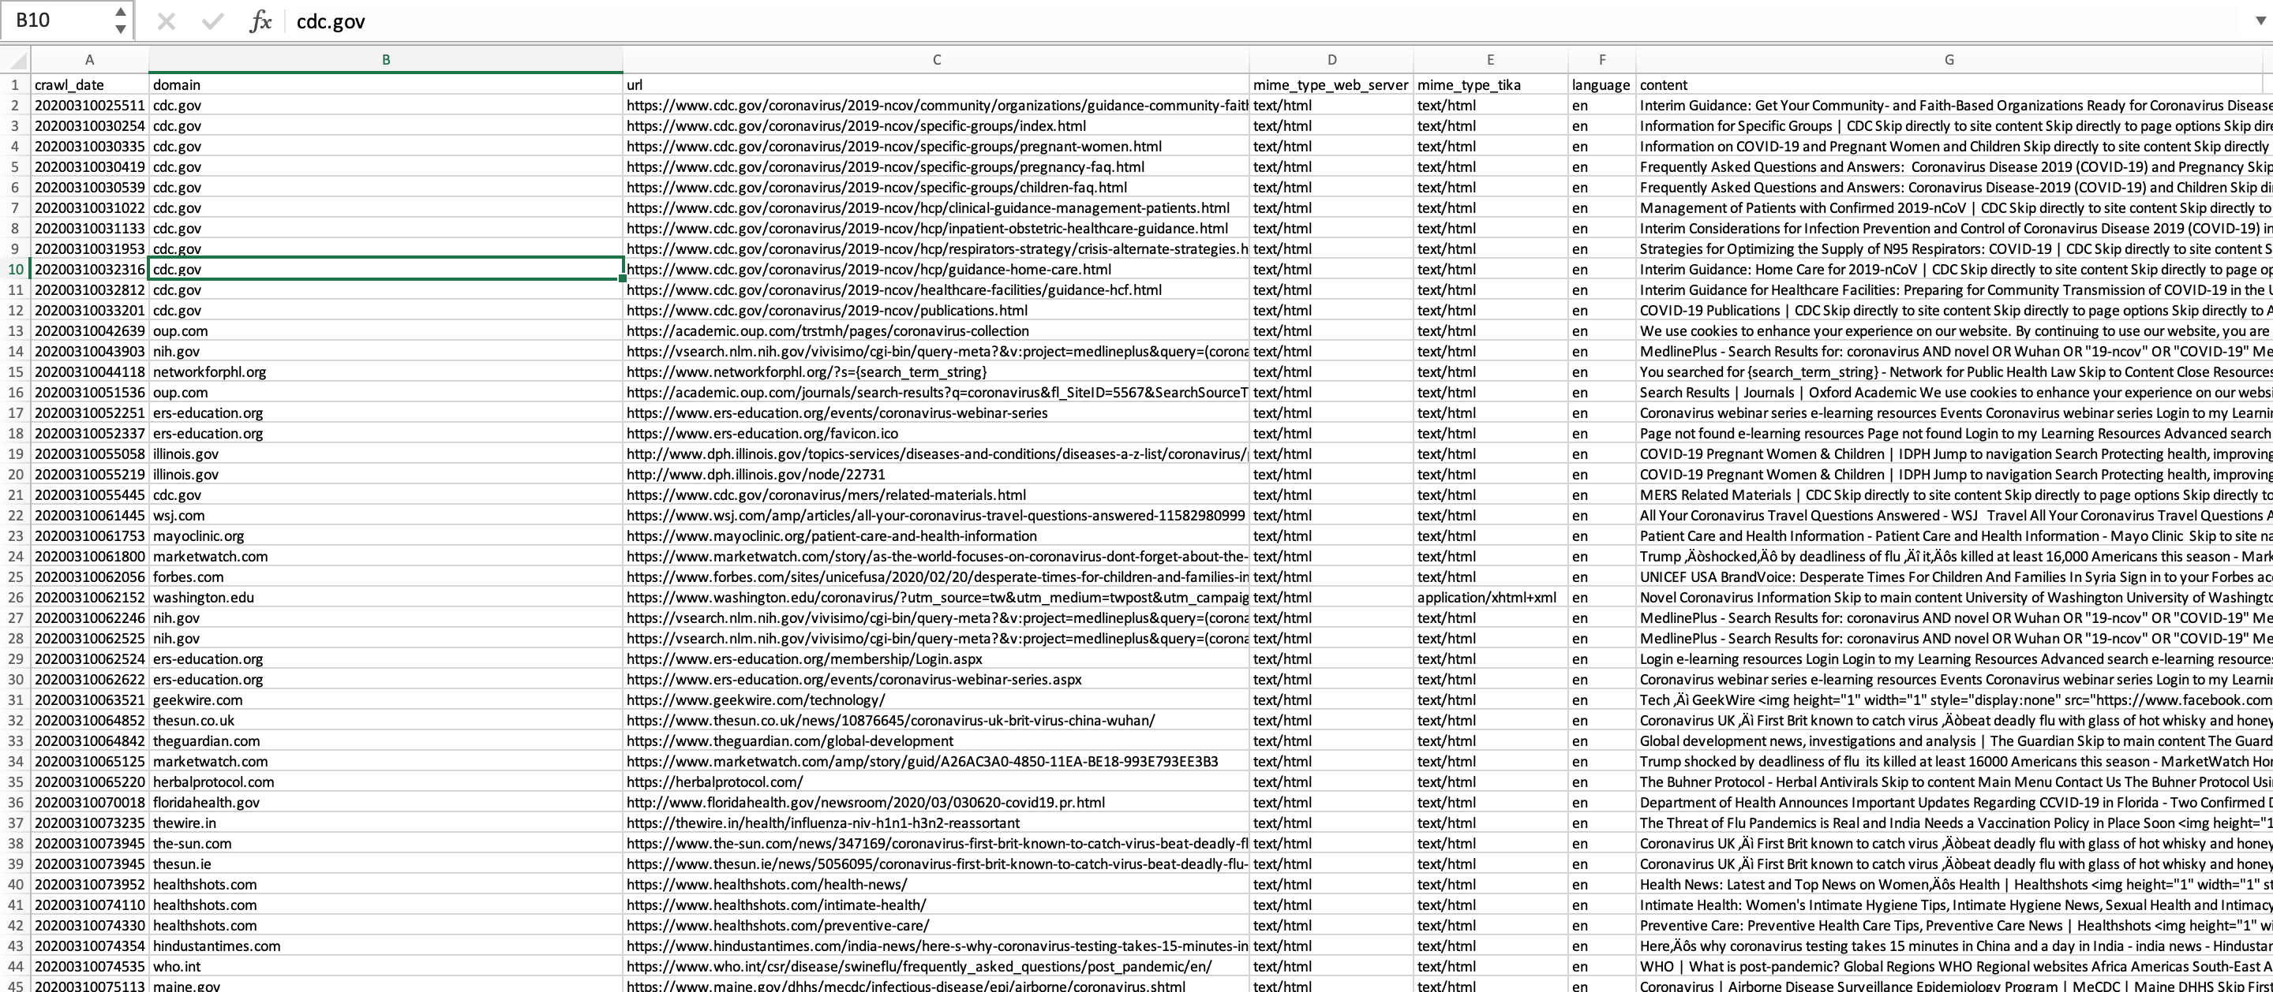

Slide 14
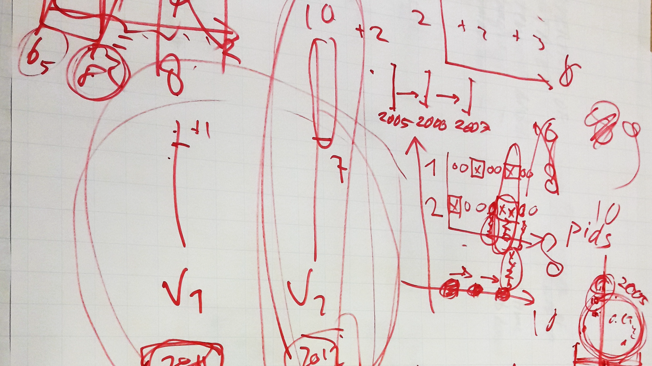

Slide 15
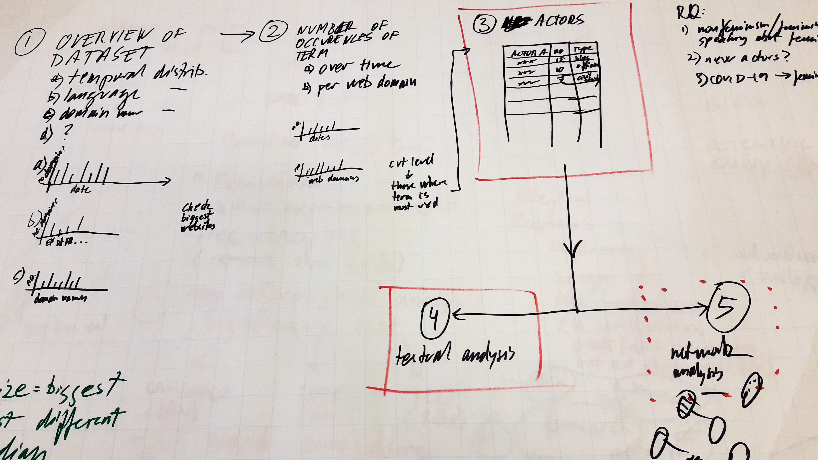

Slide 16
Our current technical challenges and issues
Information Retrieval, Text Mining and Deep Learning – Analysing the situation of women in the pandemic
Semantic search
Searching for words related to feminism like “women” “female” or “girl” etc.
Searching for bigger concepts like “feminism” etc.
Topic extraction
Looking for the topics where these words occur, topics are usually defined as words which occur together as quintessence of a document
Looking for similar Documents
Which web sites thematize woman?
What is often said about woman?
Algorithms to use
LDA, Word2Vec, Doc2Vec
By Joshgun Sirajzade

Slide 17
Topics about women in LDA (Mallet)
There are all in all 1200 topics defined for 2020 (100 per month)
26 are about women if we take grep "female\|women\|gender\|pregnancy" *
Example:
1 0.05 health world women countries global disease data news pacific development africa asia emergencies outbreak violence europe covid media international republic
14 0.05 diabetes risk women hiv treatment study blood type infection trial hepatitis health vaccine disease therapy high sexual levels sex living
58 0.05 health women alcohol pregnancy part collection resources filter private insurance apply influenza december reforms video professionals pregnant june fact brochure
By Joshgun Sirajzade
Latent Dirichlet Allocation (LDA)

